Slide 1
Data Visualisation 4
2024-2025 Data Basics
by Dr Yuhang Ye

Slide 2
TOC
Tabular Data and Graph Data
Relationship in Data: Structured, Semi, and Unstructured Data
Data Types: in a Data Science View
Two Types of Tables: Long and Cross

Slide 3
Tabular Data and Graph Data
Structure Data

Slide 4
Tabular Data
Tabular data is a common type of data format that we encounter in data visualization. In its simplest form, it's just like a table that you might create in Excel or Google Sheets. It has rows and columns, with each row representing an individual data point, and each column representing a different attribute or feature of the data. For example, let's consider the long-form table above:
In this example, each row corresponds to a different flower, and each column represents a different feature of the flower - such as sepal length, sepal width, petal length, and species. This is a classic example of tabular data, which is often used in data visualization because it's structured and easy to understand.
Most of the time in data visualization (and most time you download datasts from kaggle), we're start with tabular data.
Index | Sepal Length | Sepal Width​ | Pental Length​ | Species​
1 | 5.1​ | 3.5​ | 1.4​ | Setosa​
2 | 4.9​ | 3.0​ | 1.4​ | Versicol​
3 | 4.7​ | 3.2​ | 1.3​ | Setosa​
4 | 4.6​ | 3.1​ | 1.5​ | Virginic​

Slide 5
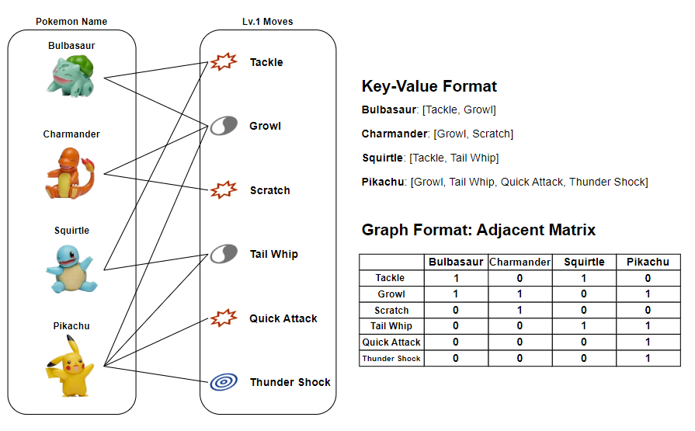
Graph (Network) Data
Network or graph data is a common data structure might seem a little more complex compared to a simple table, but it's also quite intuitive once you get the hang of it. The tabular representation is given below,
Is this table different from the previous one? Yes, it is. In the 'move' column, the table contains more than one value per cell, and these values are unordered and equally important. Although the table can represent this data, it may not be the most effective way, as there are generally fewer tools available for handling multi-value cells. We can instead convert the last column into the graph shown right.
Name | Height​ | Weight​ | Moves​
Bulbasaur | 0.7m | 6.9kg | ​Tackle, Growl
Charmander | 0.6m | 8.5kg | Growl, Scratch
Squirtle | 0.5m | 9.0kg | Tackle, Tail Whip
Pikachu | 0.4m | 6.0kg | ​Tackle, Tail Whip, Thunder Shock
Graphs can be represented in several ways, with two common methods being the key-value format and the adjacency matrix. In the key-value format, each Pokémon's name is the key, and its list of valid moves is the value. In an adjacency matrix, rows represent moves and columns represent Pokémon, with a cell marked as 1 if a Pokémon can perform a move and 0 if it cannot.
There are methods to make them more structured, like create column for each value,
1 means presence, and 0 means not presence

Slide 6
Relationship in Data
Data is typically categorized into three structural types: structured, unstructured, and semi-structured.

Slide 7
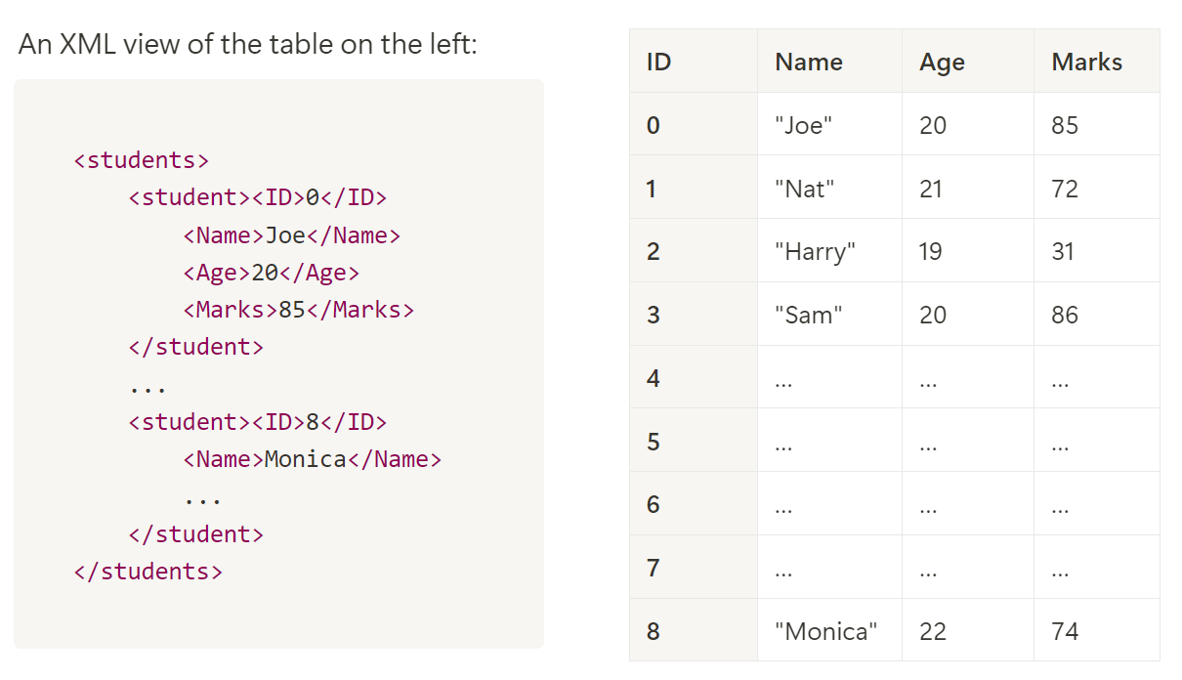
Structure of Data
schema
From the XML view, we can observe that the schema names (i.e., the dictionary keys), such as `<ID>`, `<Name>`, `<Age>`, and `<Marks>`, are predefined and correspond to the column labels in the table.
> A table has a finite number of columns, which is why its schema is finite. This makes the table an example of structured data.
Processing structured data offers several advantages:
- A table is organized in rows and columns which are visual friendly.
- It can enable clear defined data types (e.g., `int`, `str`) for each schema/column.
- It is query-able with the SQL language easily.
Structured data follows a set of well-defined format or schema, typically found in relational databases, Excel spreadsheets, and CSV files.
schema

Slide 8
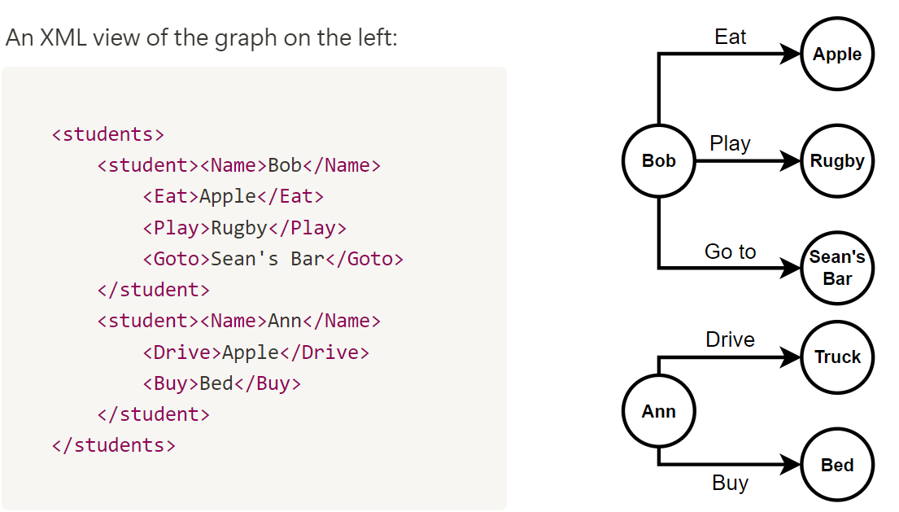
Semi-Structured Data (Tagged Data)
From the xml view, we can see, the schema are flexibly defined, that include `<Eat>`, `<Play>`, `<Goto>`, `<Drive>` and `<Buy>`. If we have more students, each one may define their own schemas. Therefore, there are no predefined schemas. With an increasing number of data, the number of schemas may increase.
> In semi-structured data, there are countless possible relationships between entities.
Processing semi-structured data offers several advantages:
Flexible and adaptable.
Retains some level of organization for discovering the relationship between entities.
Suitable for diverse datasets and evolving schemas.
and also several challenges:
Difficult to compare or sort samples.
Difficult to mapping to predict values of flexible schema..
Semi-structured data has a more flexible structure, with an infinite schema and loosely defined relationships between entities. However, it still preserves enough organization to facilitate the analysis of relationships.
schema

Slide 9

Unstructured Data (Untagged Data)
Unstructured data lacks a specific schema or predefined relationships, including formats like images, text, audio, and video. An image is a typical example of unstructured data.
While it may seem counterintuitive, the pixels in an image are actually structured data, with a defined schema including position and RGB values. However, this detailed structure is not typically useful for semantic indexing and is often overlooked.

Slide 10
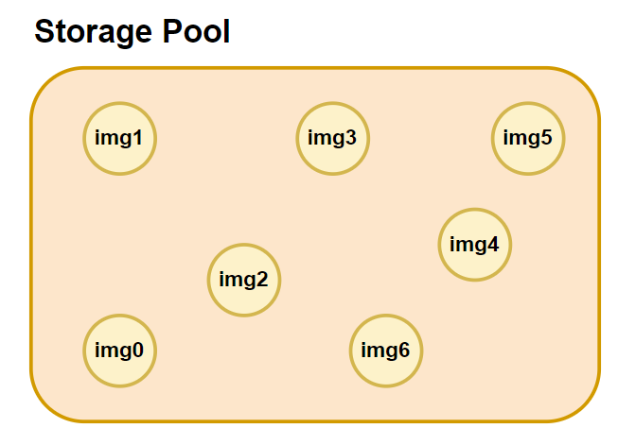
Unstructured Data (Untagged Data)
If we don't assign names to images, they are essentially isolated entities within the file system. Since there is no defined schema for the images or any relationships across images and linking to other data, they are considered unstructured data. Just like the images files in the storage pool below,
The main challenge of processing unstructured data, such as image files, is that traditional statistical tools are ineffective, as the data doesn't readily provide meaningful information or insights without more advanced processing techniques.
Visualization is useful because it creates a connection between the image and our brain's ability to interpret its meaning. This allows us to link similar images based on their content.

Slide 11
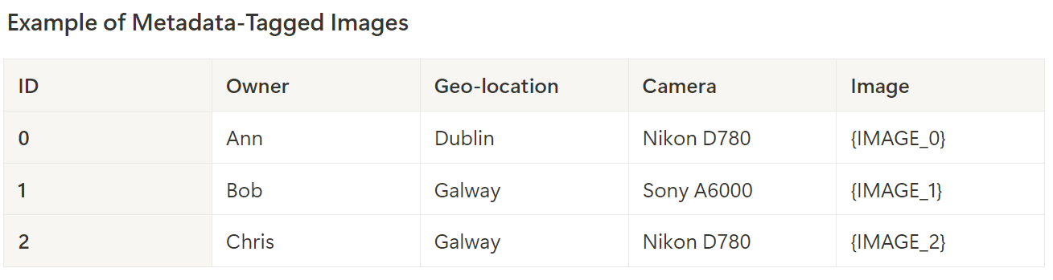
Tagging: From Unstructured Data To Structured Data
These tags enable queries and analytics such as:
"Fetch images from the same geo-location and count the number of unique cameras."
From an automated data analysis perspective, assigning names or MD5 hash tags to images creates key-value pairs, giving structure and meaning. Images with the same name may represent similar entities, while those with the same hash tag could indicate identical data or malicious duplicates. Also, adding metadata like ID, owner, geo-location, or camera type transforms unstructured images into structured data, enabling basic queries based on these tags.
These methods effectively convert unstructured data into structured data.
schema

Slide 12
Data Element Type
Understanding data types is crucial because each type requires different processing methods, tools, and interpretations. Data types determine how we manipulate, analyze, and visualize information, whether through statistical methods or machine learning models.

Slide 13
Quantitative Data
Quantitative data is all about measurable quantities, such as distance in miles, temperature in degrees, time in hours, or prices in euros. The term "quantitative" reflects this focus on quantities, which allows for precise mathematical operations like addition, subtraction, multiplication, and division—capabilities that aren't possible with all types of data.
An essential feature of quantitative data is that the intervals between numbers are clearly defined and consistent.
This means the difference between two values, such as between 10 and 20, is the same as between 30 and 40, enabling accurate comparisons.
Because quantitative data is number-based, it also supports the use of statistical techniques like mean, variance, and correlations. These methods help us identify trends, discover patterns, and make predictions, such as forecasting stock prices based on historical data.
Very Important

Slide 14
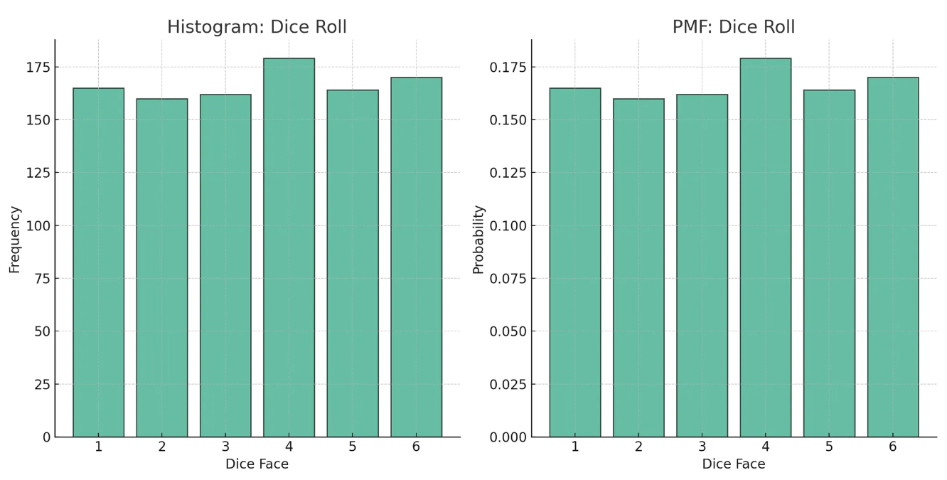

Quantitative Data (Continuous vs. Discrete) - Discrete
Discrete data consists of numerical values that represent countable, distinct units and cannot be broken down into smaller parts.
This type of data is typically generated through counting.
For example, when rolling a dice, the number on each face is discrete, and after multiple rolls, you can count how often each number appears.
continuous
Both are discrete data

Slide 15
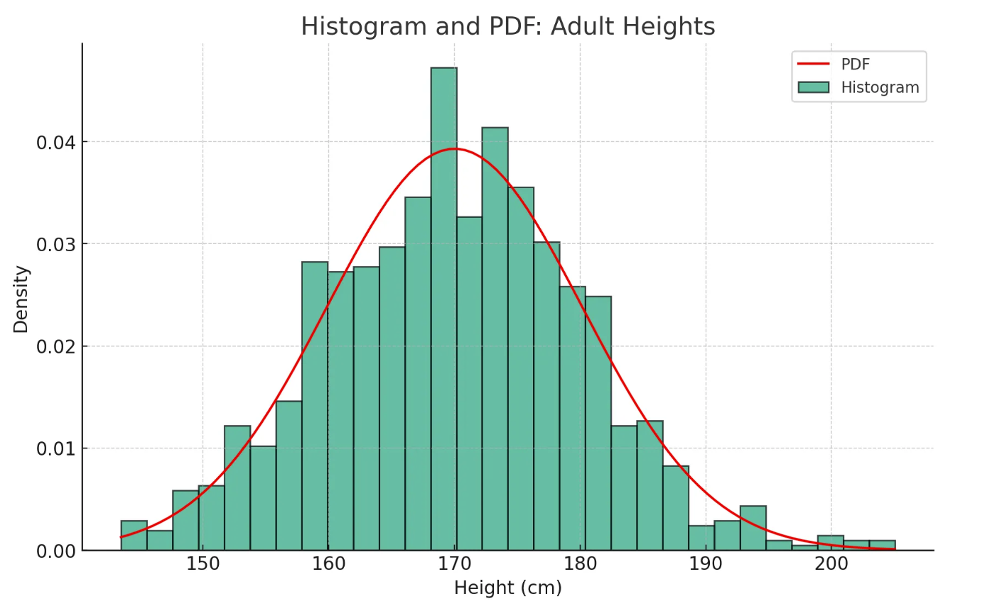
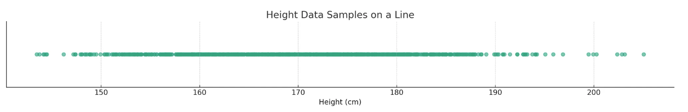
Continuous Data
In this context, the histogram serves as an empirical construct that delineates the density distribution of these binned heights. Notably, this histogram is density-normalized, aligning it closely with the Probability Density Function (PDF), which provides a theoretical, continuous representation of the data distribution.
Height usually is treated as a continuous variable, it’s unlikely to find two people with the same height down to the smallest unit.
Each height value is typically unique, as shown in scatter plots, resulting in a count of 1 for each distinct height.
This uniqueness makes it hard to identify patterns or gain insights from such a representation.
Instead of focusing on the exact height frequency, a better approach is to look at how many individuals fall within specific height ranges.
This method is more suitable for continuous data, as the chance of finding multiple people with the exact same height, down to the last decimal, is very low.
By grouping individuals into height ranges or bins, we get a more meaningful and summarized view of the data.
each value is unique
Density is invisible

Slide 16

Ordinal Data
What is the difference between 4 star and 5 star
The distance between 3 star and 4 star is different from 4 star and 5 star
Ordinal data is related to order or rank.
It is a type of categorical data that has a specific order or scale.
However, the differences between data points are not consistent or measurable.
You can determine if one value is greater than another, but you cannot quantify the exact difference between them.
Comparing and Sorting are valid.
Examples of Ordinal Data
Customer Satisfaction: Very Unsatisfied, Unsatisfied, Neutral, Satisfied, Very Satisfied
Education Level: Primary, Secondary, Bachelor's, Master's, Doctorate
Social Class: Lower, Middle, Upper
Severity of a Disease: Mild, Moderate, Severe

Slide 17
Ordinal vs. Discrete
It's a frequent oversight to conflate ordinal and discrete data types. While both may appear to represent categories or levels, their underlying mathematical properties differ significantly, particularly in terms of defined intervals and permissible operations.
When rolling a standard six-sided dice, the numbers 1 through 6 represent discrete data. Each value is a specific, countable number, and the intervals between values are fixed and equal. This allows for meaningful mathematical operations such as addition and averaging. For example, if you roll the dice five times and sum the results, you can calculate an average roll value, which has a clear interpretation because the distance between each number is consistent.
Now, consider skill levels in a video game, such as beginner, intermediate, and advanced. These skill levels are ordinal data, meaning they represent a specific order, but the intervals between them are not necessarily equal. The difference in skill between intermediate and advanced might be large, while the difference between beginner and intermediate could be small. As a result, applying quantitative operations like addition or averaging to skill levels doesn’t make sense. For instance, if you want to achieve a skill ranking of 5 (perhaps representing an expert level), it does not equate to adding two players with skill rankings of 2 and 1. The concept of '2 + 1' in this context is meaningless because the intervals between skill levels are not fixed or consistent, and you can’t combine them in a straightforward mathematical way.

Slide 18
Nominal Data
The name "nominal" originates from the Latin "nomen", meaning "name", which alludes to the key feature of this type of data: it is differentiated by naming or labelling. The categories within nominal data are distinct and cannot be arranged in a logical sequence.
Unlike quantitative or ordinal data, you cannot perform mathematical operations on nominal data - that is, it does not make sense to add, subtract, multiply or divide the categories. Furthermore, one cannot state that one category is greater than, less than, or equal to another. In other words, nominal data offers no basis for measuring the distance between different categories.
The emphasis with nominal data is purely on counting the number of samples per category. Nominal data can provide valuable information about the prevalence or frequency of categories within a data set. For instance, it can answer questions like "how many?" or "what proportion?" but not "how much more?" or "how much less?".
Examples of nominal data include:
Animal species - e.g., 'dog', 'cat', 'mouse', 'bird', and 'fish', each species signifies a different category.
Movie genres - e.g., 'horror', 'comedy', 'drama', and 'action', each genre forms a distinct category.
Blood types - e.g., A, B, AB, and O, each blood type denotes a separate category.

Slide 19
Examples of Nominal Data:
In engineering and computer networking, certain data types may appear number but are actually categorical.
Examples include
Task IDs, which are numerical but serve only for identification;
IP Addresses, which are numerical labels for network devices but lack quantitative meaning;
Port Numbers, which identify specific network processes but hold no mathematical significance.

Slide 20
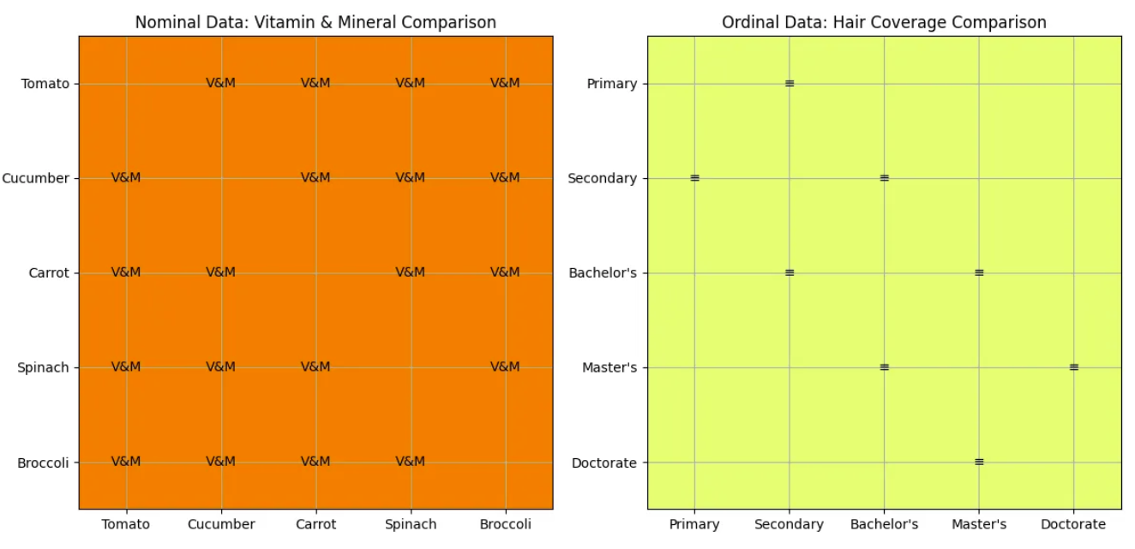
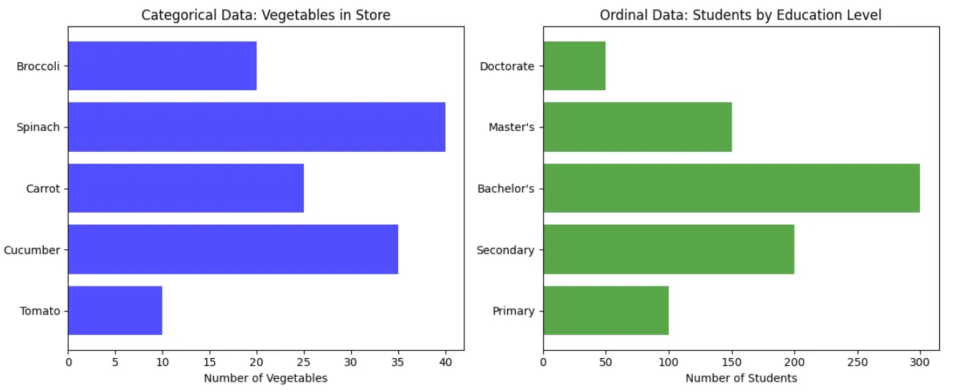
Nominal Data vs. Ordinal Data Affects the Visualization and Analysis
For example, unlike ordinal data that can be compared in a single direction along its ordered scale, nominal data requires pairwise comparisons across all categories.
Any order
sorted
Any order
sorted
For visualization, the categorical data, when being arranged in an axis, the categories can be of any order. However, for ordinal data, the ordinal data are usually arranged in a given order which is consistent to the semantic order of the ordinal data.

Slide 21
Binary Data – Nominal Or Quantitative
Binary data is a unique data type with only two distinct categories, much like a simple "yes or no" question. It can be either nominal or quantitative, depending on the context. Here are two examples:
In the question "Is this cat calico or not? ", the answer is binary but purely nominal—the categories (calico and non-calico) have no inherent order or value.
Conversely, if you ask, "Can this cat climb a tree?", the response is still binary (yes or no), but it implies a quantitative aspect, where being able to climb could be seen as a higher capability than not climbing.
In such cases, binary data could be considered ordinal or quantitative, and you could, for example, compare the average climbing ability between different groups of cats.

Slide 22
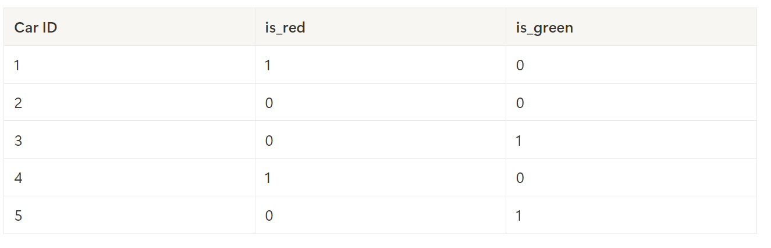
Converting Nominal Binary Data to Quantitative
To utilize nominal binary data in statistical models, we often use **one-hot encoding** or create **dummy variables**. This method transforms categorical binary data into numeric form.
**Example:** Consider a dataset of car colors: Red, Green, and Blue. Using dummy variables, we create two binary columns: `is_red` and `is_green`. If a car is red, `is_red = 1` and `is_green = 0`; if it's green, `is_green = 1` and `is_red = 0`. A blue car, as the reference category, would have both `is_red = 0` and `is_green = 0`. This allows the nominal color data to be used in models requiring numeric inputs. The resulting dataset might look like this:
By encoding nominal binary data this way, it becomes usable for various quantitative analyses while maintaining the integrity of the original categories.

Slide 23
Two Types of Tables
In data analytics, two primary table formats are commonly used to organize and analyze data:
long format and wide format. Understanding these formats is crucial as each serves different purposes and is suited for various types of analysis.

Slide 24
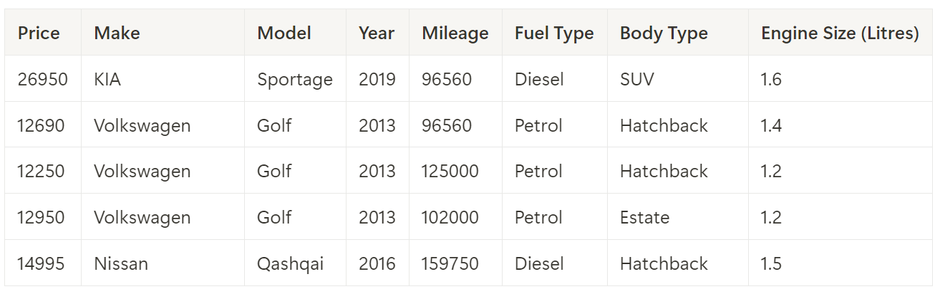
Wide Form Table
Schema: Nominal or Ordinal
A wide format table, is structured such that each row represents a single observation or instance of data, and each column represents a distinct variable or attribute of this instance. This format is highly versatile and is often used for raw data where each row corresponds to a specific record or event.
Here is a typical example of a wide-form table:
Select some rows
Process each cell
Row index: Ordinal
Attribute Name
For example, in a dataset containing information on second-hand car sales, each row might represent a single car, with columns for attributes such as "Make," "Model," "Year," "Price," and "Mileage."
This format is ideal for performing data transformations, filtering, and other types of data manipulation, as it preserves the granularity of each individual observation.
1
Attribute Value
2
3
4
5

Slide 25
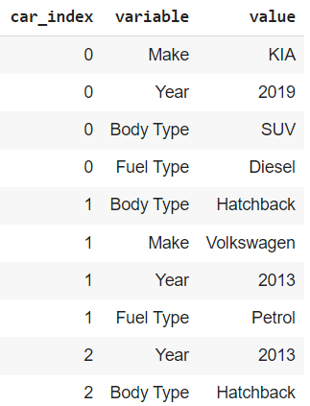
Long Form Table
An id=0 of interest (sample index)
Each observation in a separate row: In long-form data, every individual measurement or observation has its own row.
One variable per column: Each variable is represented by a separate column (e.g., time, value, category).
Multiple entries for a single sample: For a single entity (e.g., a person, location, or experiment), there may be multiple rows, each representing a different measurement or condition.
Common for time-series and repeated measures: It's ideal when you have repeated observations or measurements over time or across categories.
Attribute Name
Attribute Value

Slide 26
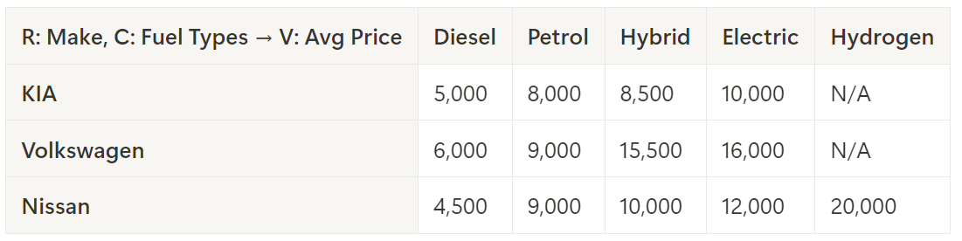
Cross Form Table (both index and column are attribute values) [Also Wide Table]
A cross-tabulated table (cross table), organizes data in a summarized way.
Most data analytic software includes a feature called pivot tables, which allows users to aggregate data as needed and convert long format data into a summarized wide format.
Here is a typical example of a cross table. It summarizing the average car price data, rows represent different car makes, columns represent different fuel types, and the cell values show the average price for each fuel type.
This format provides a quick overview of how average prices vary by car make and fuel type, but it lacks the detail (e.g., every car’s price) of a long format table, making it less ideal for analysis that requires information on individual cars or more granular attributes.
Column
Attribute Value
Attribute Value
Aggregated attribute value from a different column
value
Index

Slide 27
Series and DataFrame
Practical Coding Stuff

Slide 28
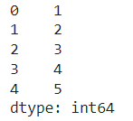
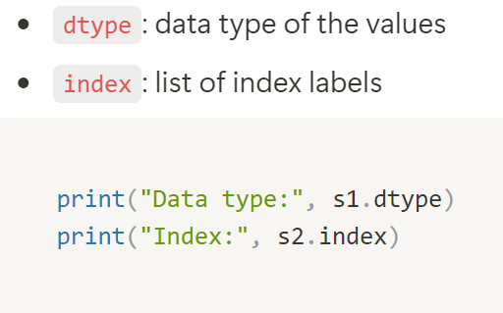
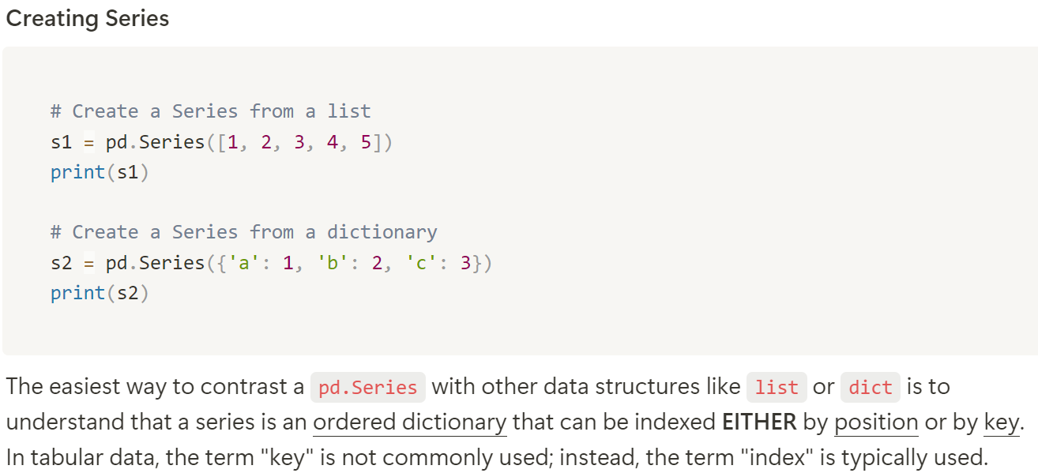
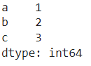
Series in pandas
A Series is a one-dimensional array-like object that can hold many data types, including a mix of integers, strings, floating-point numbers, Python objects, and more.
index
attribute value
attribute name?
Not defined yet in Series
a Pandas Series can support mixed data types

Slide 29
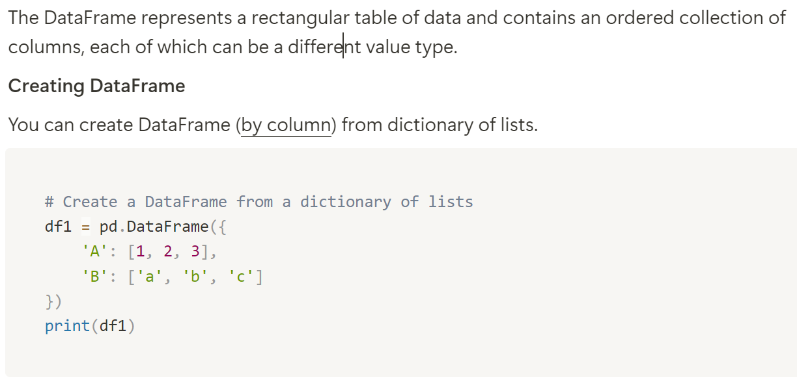
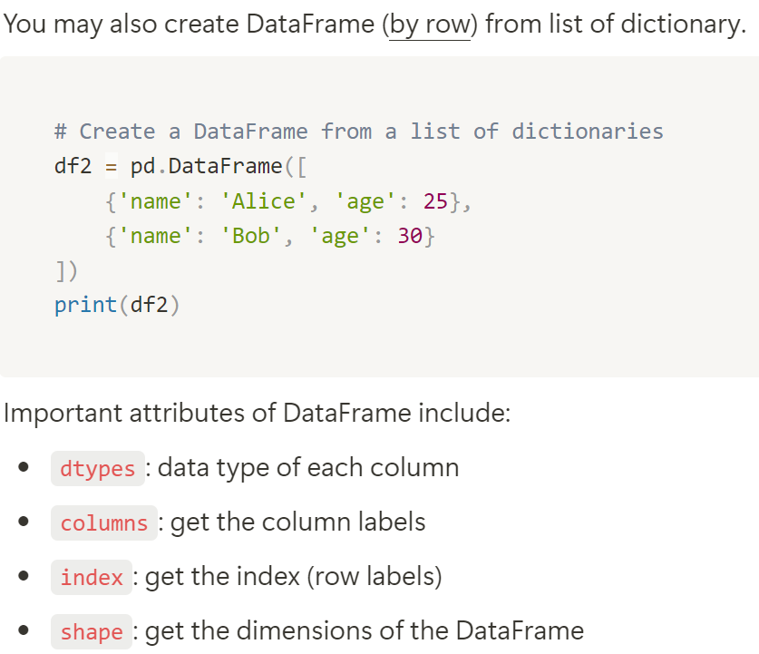
DataFrame in pandas
Index = [1, 2, 3]
attribute name
attribute value

Slide 30
Series and DataFrame
Basics

Slide 31
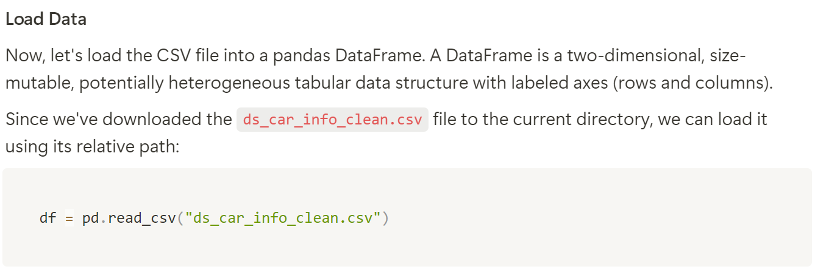
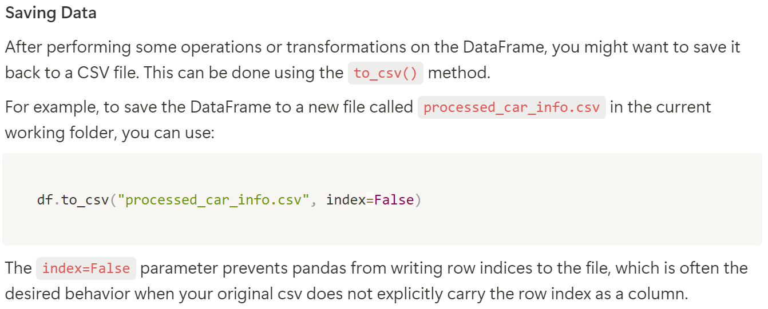
Load/Save

Slide 32
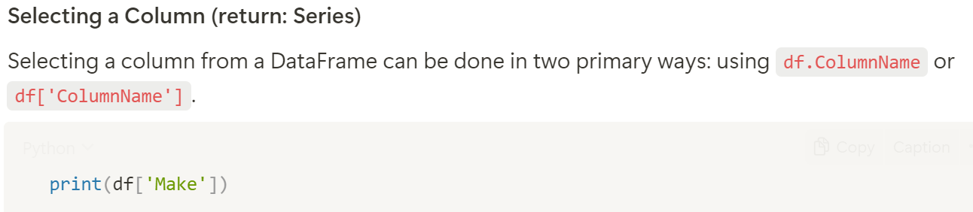
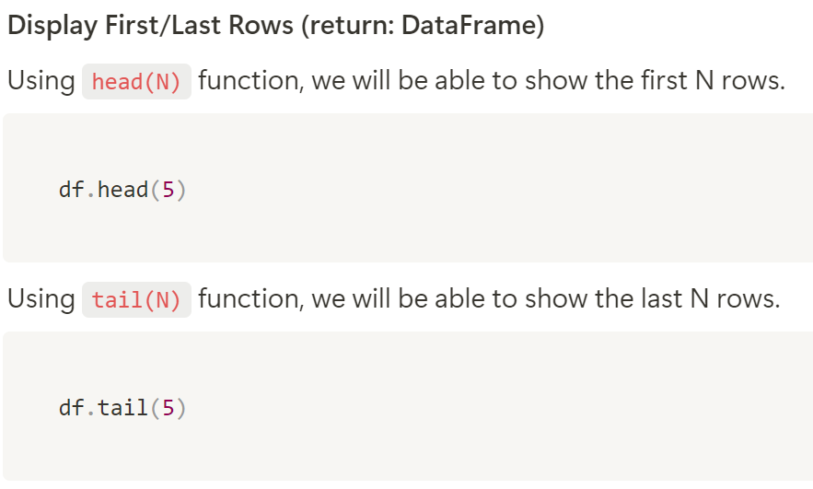
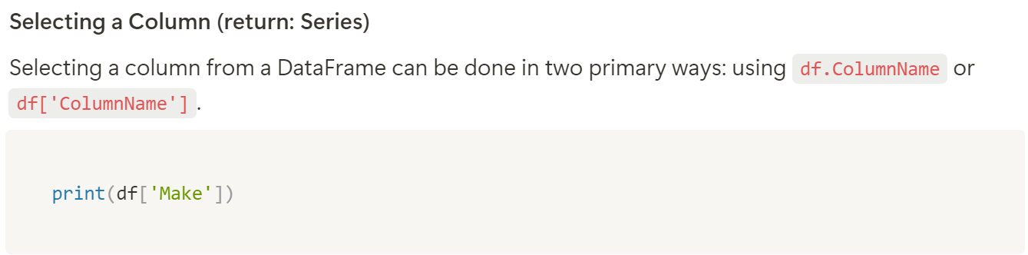
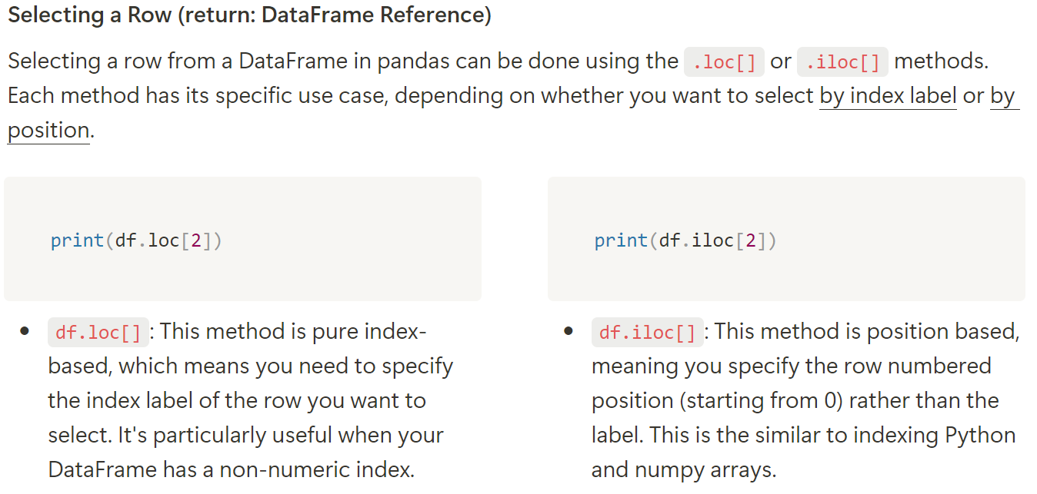
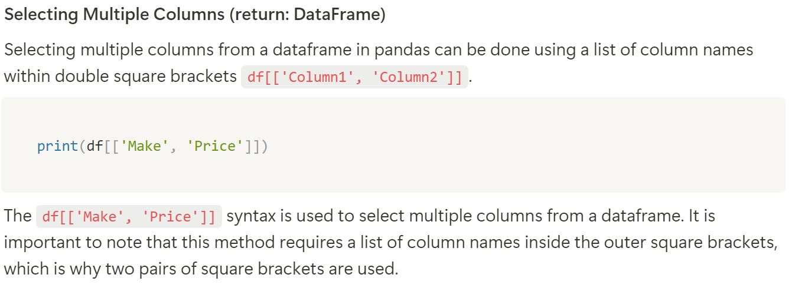
Data Access

Slide 33
Data Access

Slide 34
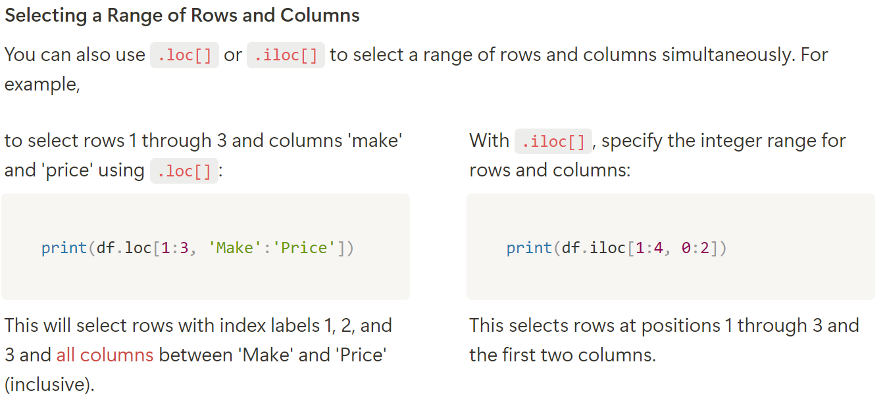
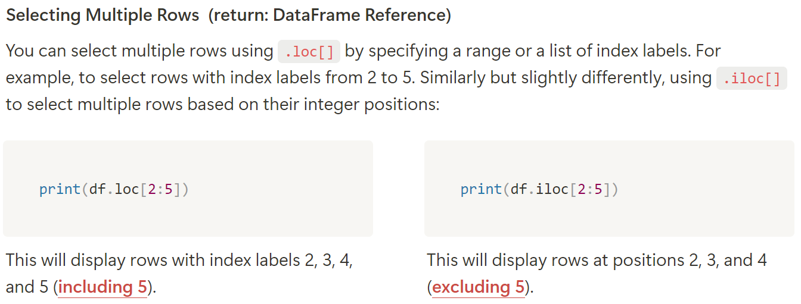
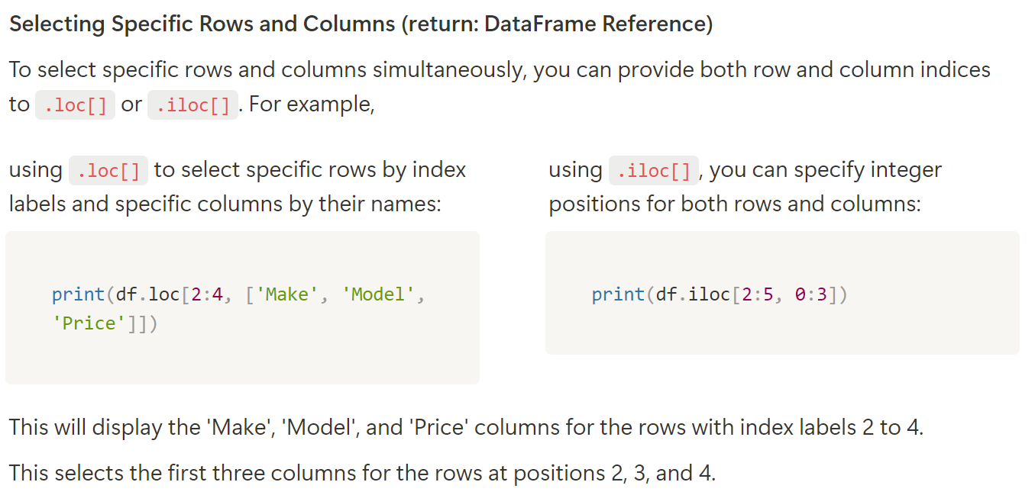
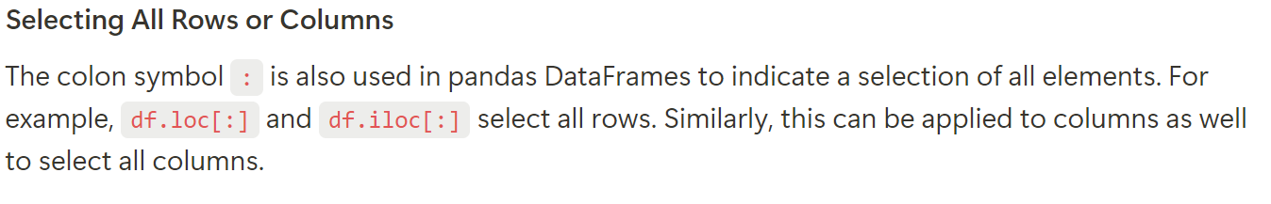
Data Access

Slide 35
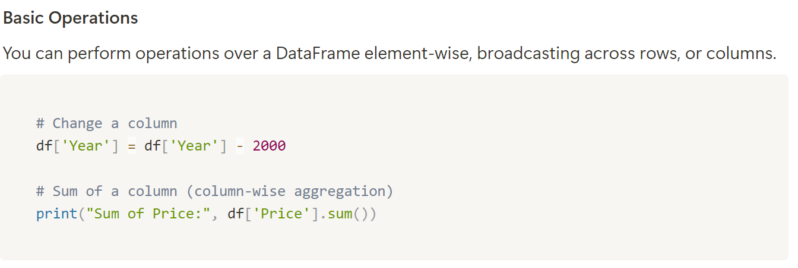
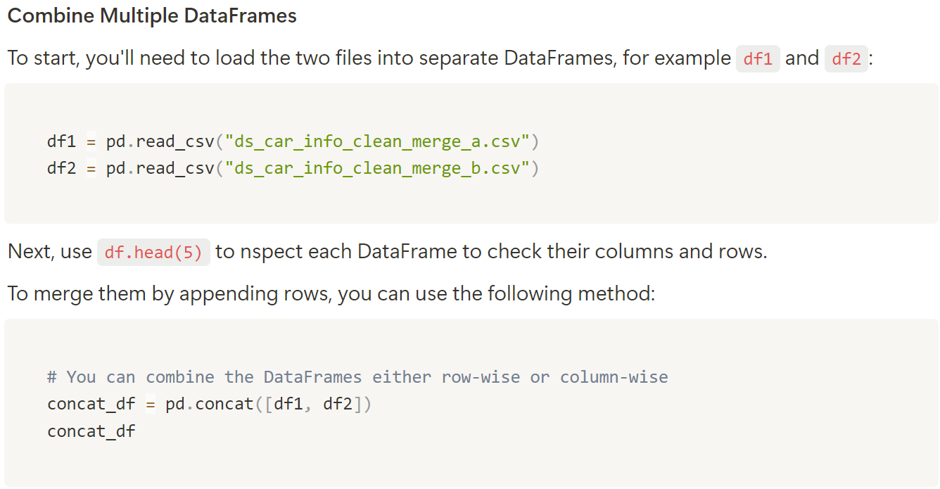
Data Manipulation

Slide 36
Data Viz 4
Thank You

